Slide 1
Vertical Slice Architecture

Slide 2
1.
Clean Architecture
also known as
Ports & Adapters
Hexagonal
Onion

Slide 3
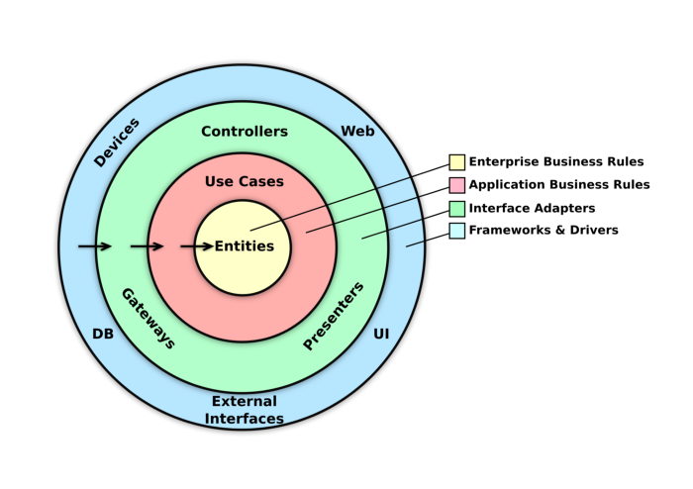
Principles
Monolithic in its approach
Mock-heavy, rigid rules around dependency management
Abstractions around most concepts
Heavy coupling within a layer, light coupling between layers
Very D of SOLID
Notes:
Monolithic in approach - Because of the way the system is structured, like an onion, it’s monolithic in its approach. Splitting off features/capabilities for things like scaling out can be a lot of effort.
Mock Heavy - Any layer that wants to talk to another layer has to be through an interface. Tests have lots of mocks or stubs created for them.
Abstractions – Repository pattern, Service pattern which leads back to rigid rules appearing on how code must flow e.g. controllers MUST talk to a service which MUST use a repository

Slide 4
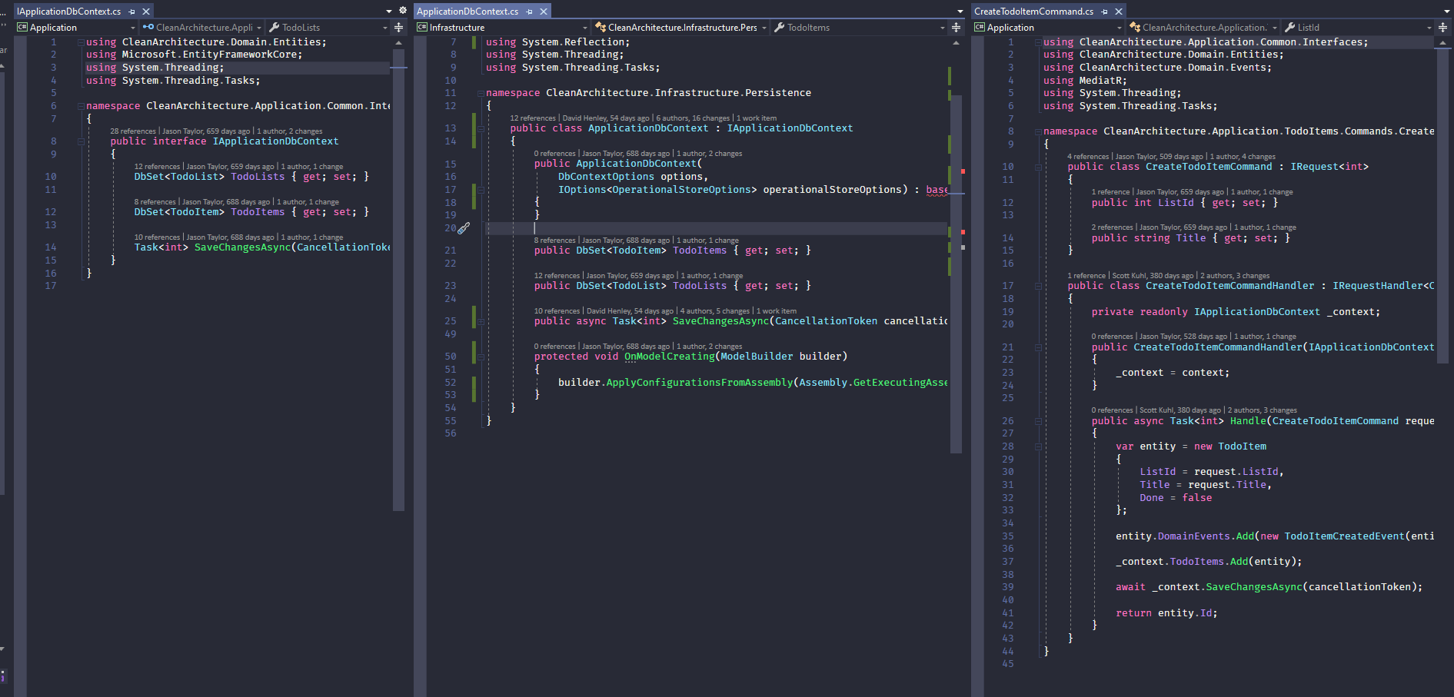
A Different Perspective

Slide 5
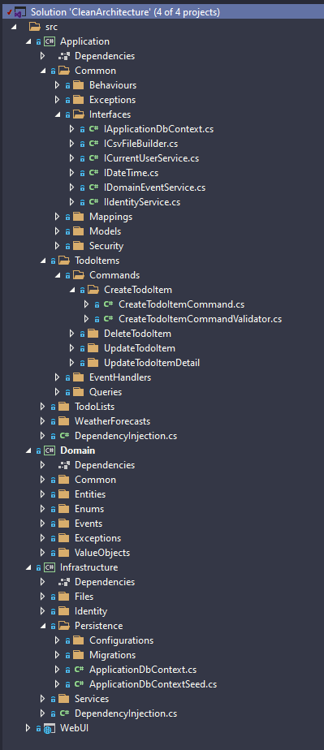
A Different Perspective
Notes:
Some of you with a keen eye who may already be familiar with VSA may see that this is already applying a hybrid approach – VSA within CA. I’ll talk more about that later.

Slide 6
Some Benefits (?)
Independent Infrastructure
We can swap out the entire database implementation across the board
Independent UI
The UI can change easily without changing the rest of the system
Testable
You can test business rules without a UI, database, etc. because of mocks

Slide 7
My Experience
Methods (thru interfaces) which are used horizontally across the application
Lasanga services
Lots of time navigating the file structure of the application
Easy to write low-value tests which are brittle
Hard to approach modifying or adding new features because of the coupling
Lots of worrying about side effects
😭
Ben
Notes:
I’ve seen a lot methods with booleans that change the behavior of the method entirely. Especially services close to the repository (give me users ordered by data, give me users who are inactive, etc.). Because these are used by so many things they are effectively impossible to change without huge amounts of effort – even with tests in place.
- Lasanga services - Services calling services calling services calling services… The layers of indirection from interfaces are extremely hard to mentally keep track of and debug.
Horizontally used methods leads to this service soup where you’ll have “business” services dealing with business logic, data services for different ways of grabbing data, throw in a repository layer. Your business services call other business services and data services, whose business services also call other business services and data services, etc.
- Navigating - When I do go to make a change, I have to flip between a multiple different folders and files to make changes in a dozen different places.
Low-value - “Does service A call service B”. This tells us very little most times and, as a twisted knife, it again causes a lot of paralysis when we do want to refactor code because now all our tests break. The interface changed, we aren’t importing this service anymore inside the constructor, etc. All these tiny little breaks all the time for the simplest of stuff. It’s not that the tests no longer pass – the code most times wont even compile because of these breaks. These types of breaks aren’t inherently bad, don’t get me wrong, but it’s the latitude of these since they’re horizontally slice that makes this a pain in the ass.
Hard to approach – Makes understanding the “why” of the system very hard. To the last point, when you have tens of thousands of tests and hundreds of them break because of an interface change – people will work around doing so or simply won’t make the change at all. These abstractions are supposed to HELP with the projects ability to change but in my experience its been the opposite. Change requires surgery.
Side effects – I’m in constant fear of breaking something unrelated.

Slide 8

y tho?
- Anonymous

Slide 9
2.
The Vertical Slice

Slide 10
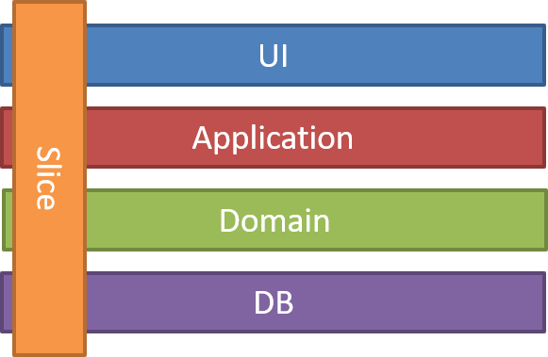
Principles
Use-case driven in approach
Built around requests (slices)
No gates or barriers across layers
Heavy coupling within the slice, light coupling between slices
Very S of SOLID
Notes:
Requests – I always think to myself an HTTP Request, but obviously this doesn’t always apply or make sense depending on the context.

Slide 11
What is a Single Responsibility?

Slide 12
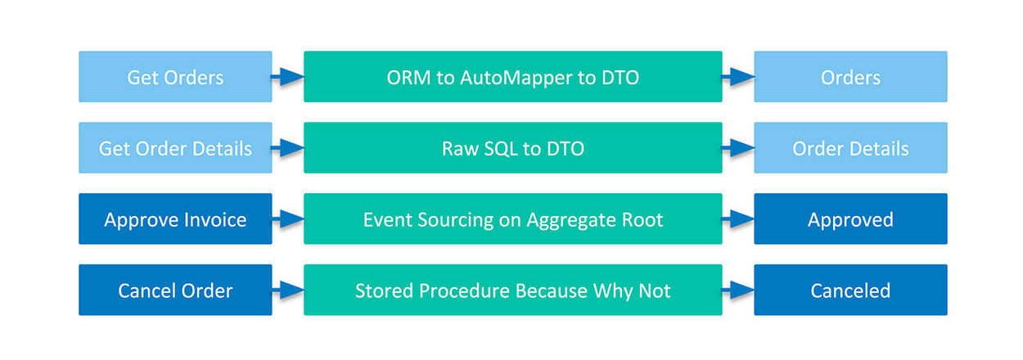
Emergent Patterns
Command Query Responsibility Segregation
Domain-Driven Design
Higher order tests
Group by feature
Notes:
CQRS – Command Query Responsibility Segregation which I’ll remove the nuance of it by saying its all about separating your reads from your writes.
DDD – rich domain model
Group By Feature – some languages and frameworks are less opinionated on their structure but this follows the principle of keeping things related by feature to each other close and things unrelated to that feature far away. Things that change together belong together. I’ll dive into some .NET code that demonstrates this.

Slide 13
The Axis of Change
When we modify our system where do we go?

Slide 14
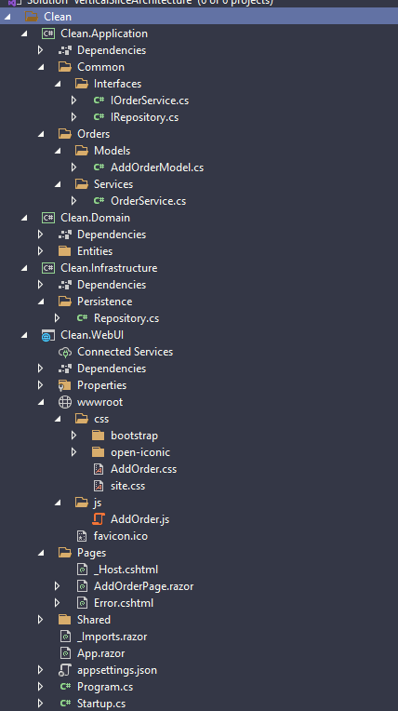
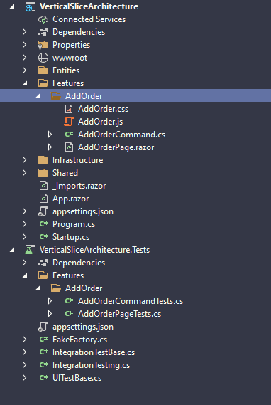
As a shopper… I want to place an order with a list of products so that I can receive them at a later date

Slide 15
Benefits
Code is largely added rather than changed
Fewer side effects
Incremental refactoring
Scaling out / Microservice-oriented
Less paralysis surrounding change
Ubiquitous Language
Notes:
If a feature needs to switch from an ORM to a lighter ORM, a stored proc, or maybe even an external data source entirely like an Web API, making that change for that one slice is very easy and you don’t need to bring in a huge amount of abstraction.
Vertical scaling – lift & shift, lets say showing a product list page gets a huge amount of hits after launch. Moving code onto the cloud, into containers, into a function, etc. by feature is a lot easier when that feature is largely isolated by itself.
Less paralysis – Because we can

Slide 16
Some Pitfalls
Good domain design skills
Framework/language is opinionated about feature grouping
Framework/language not conducive to higher-order tests
Like many things – don’t treat it as a golden hammer

Slide 17
Stop focusing and organizing by technical concern but rather start focusing and organize by the features and capabilities of your system.
- Derek Comartin

Slide 18
Hybrid Approaches
Vertical Slice Architecture
Group by feature inside of each layer
Higher order tests
CQRS
Clean Architecture
Abstractions
Rigid rules

Slide 19
3.
Further Your Mastery

Slide 20
Resources
NDC Sydney 2018 - VSA – YouTube (Jimmy Bogard)
Organize Code by Feature | Vertical Slices – YouTube (Derek Comartin)
Vertical Slicing in Agile – Book (TJ Rerob)
VSA – C# GitHub Repo (Jimmy Bogard)
Hybrid CA / VSA – C# GitHub Repo (Jason Taylor)
This presentation & code examples (Me)
DynamoLeagueBlazor (Me)

Slide 21
Thanks!
Any questions?

